Slide 1





SymCheck
Briana Figueroa
Swapnil Kadekar
Morgan Franklin
Sprint 6 Presentation
Team 5
Sayema Islam
Alan Singleton
HiddenAgility

Slide 2
Agenda
Project Recap
Sprint 5 Recap
Sprint 6
- Committed, Completed, and Uncompleted Tasks and Stories
- Burndown Chart
- Acceptance Criteria
Project Timeline
Retrospective
- Test Case
- Deliverables
- Sprint 7 and 8 Backlog
Conclusion
- What is SymCheck
- Technologies being used
- Completed Tasks and Stories
- Screenshot of new features
HiddenAgility

Slide 3
Project Recap
HiddenAgility

Slide 4

What is ?
An image-based, self-diagnosis web application
A patient’s uploaded image analyzed by an original algorithm
This algorithm is developed, tested, and ran using TensorFlow's Keras library
SymCheck diagnoses 2 illnesses: chickenpox (varicella) and pink eye (conjunctivitis)
The use of SymCheck could thus also help in mediating the spread of COVID-19 by reducing the traffic in Urgent Care facilities.
Does not require account creation or login, nor answering a long serious of monotonous questions (image-based)
HiddenAgility

Slide 5
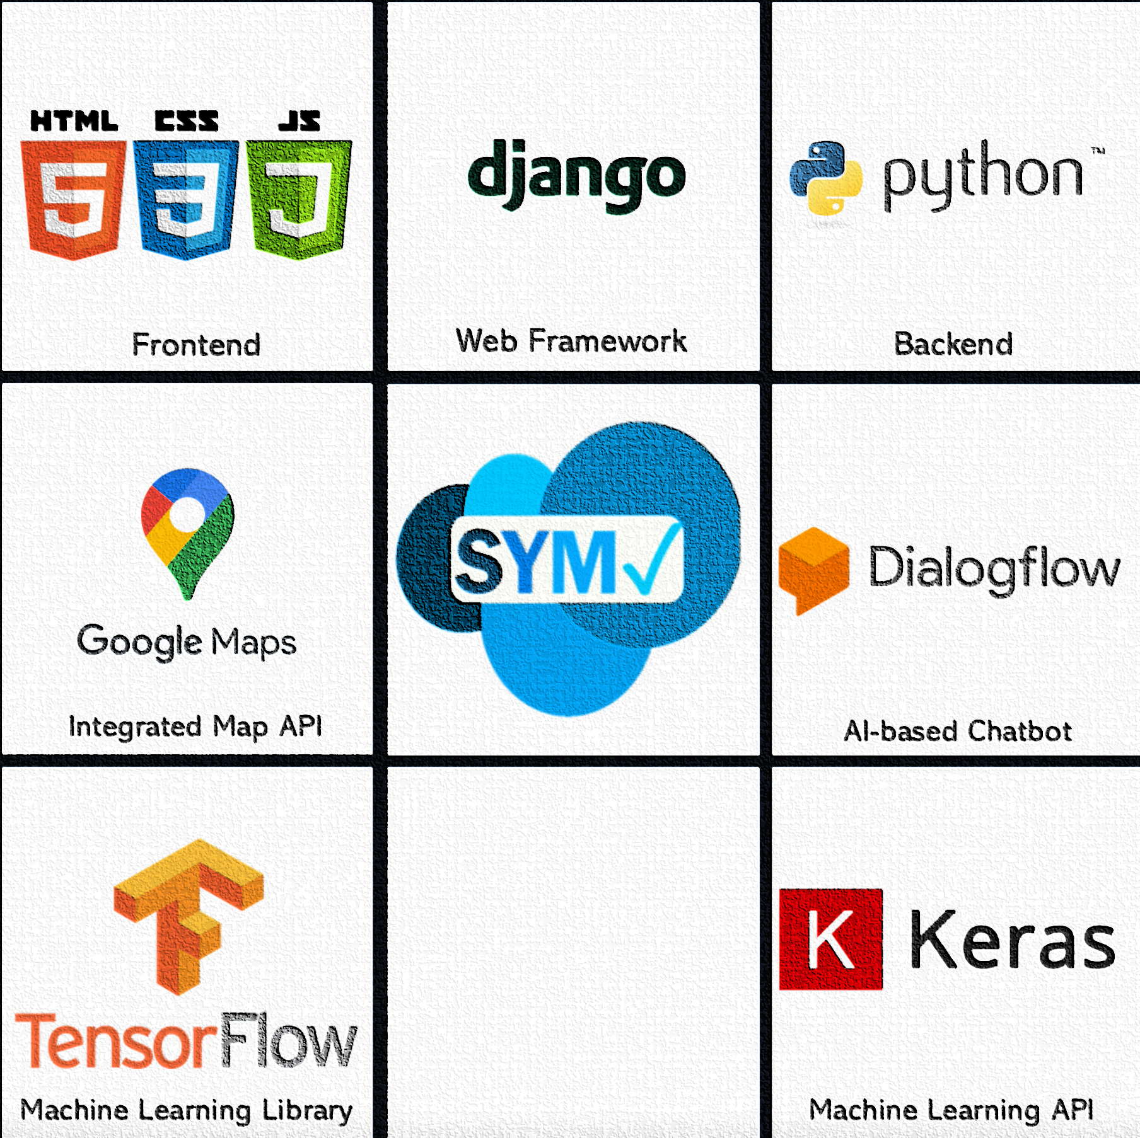
Technologies used in SymCheck
?
HiddenAgility

Slide 6
Sprint 5 Recap
HiddenAgility

Slide 7
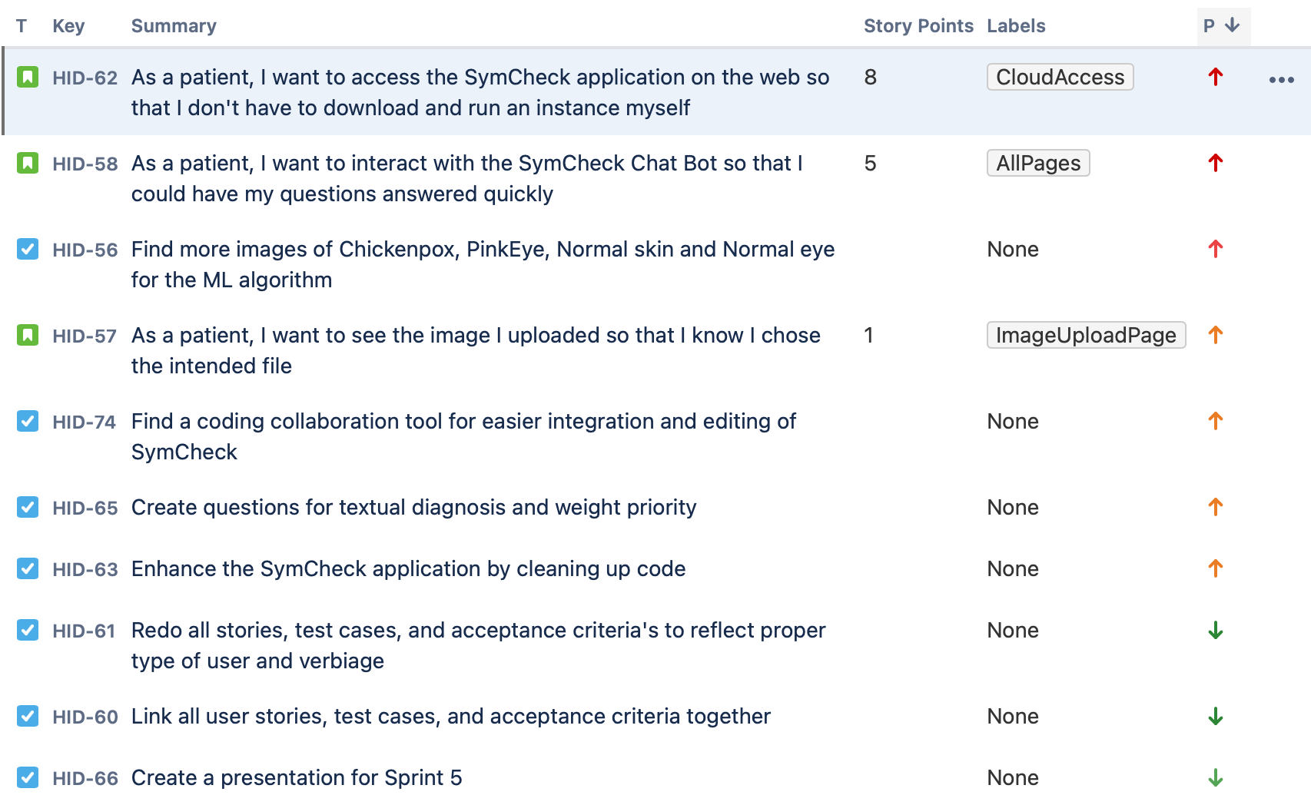
Sprint 5 Deliverables
We added a new capability that allows you to see the image uploaded for confirmation purposes.
We added a chatbot to each page that acts as a virtual assistant for SymCheck.
It can direct users to various resources such as our GitHub, the CDC website, or reach us via email
We hosted our application to the cloud for easier accessibility.
Users can access SymCheck on any laptop or desktop
There is no need to install and run SymCheck on your device
HiddenAgility

Slide 8
Sprint 5 Screenshots
New Image Page Capability
Chatbot Capability
HiddenAgility

Slide 9
Sprint 6
HiddenAgility

Slide 10
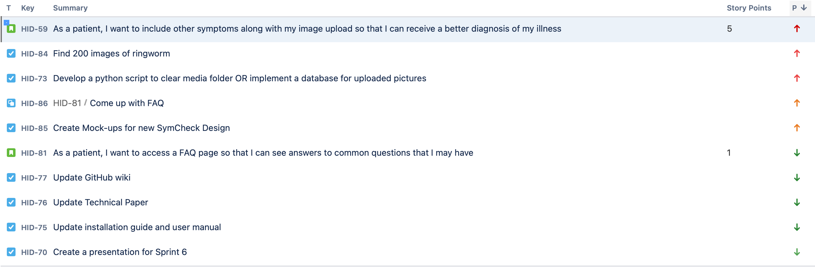
Sprint 6 Committed Tasks and Stories
Metrics
2 User Stories
7 Tasks
1 Subtask
6 Story Points
HiddenAgility

Slide 11
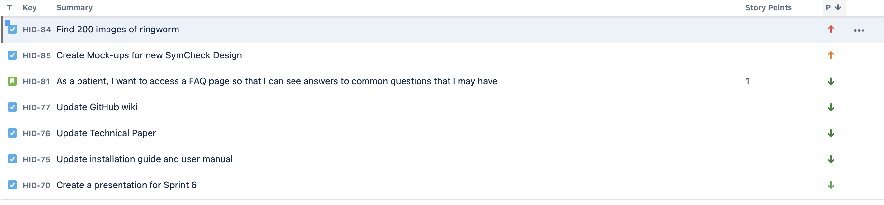
Sprint 6 Completed Tasks and Stories
Metrics
1 User Story
6 Tasks
1 Story Point
HiddenAgility

Slide 12
Sprint 6 Uncompleted Tasks and Stories
What went wrong
Advance Prediction Page
Repl.it
No longer supports large installation
Tensorflow cannot be downloaded
Unable to perform real-time collaborative programming due to Repl.it failure
Backend logic still needs work
HiddenAgility

Slide 13
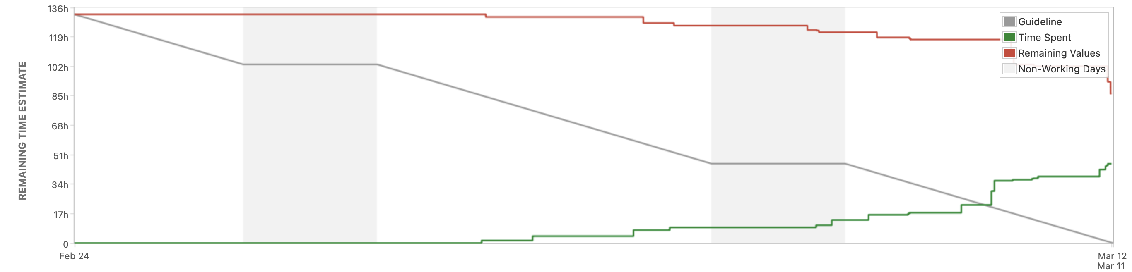
Sprint 6 Burndown Chart
HiddenAgility

Slide 14
Sprint 6 Deliverables
HiddenAgility
Notes:
Briana Figueroa

Slide 15
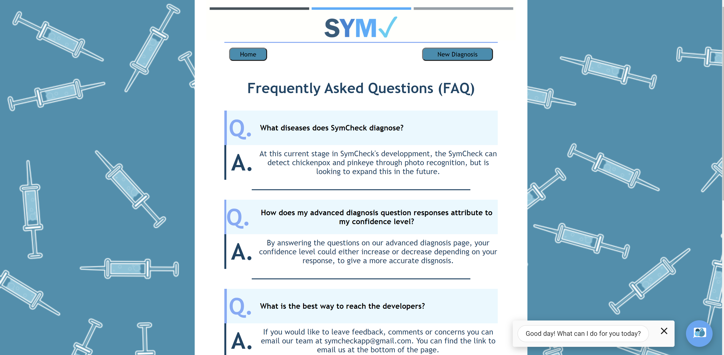
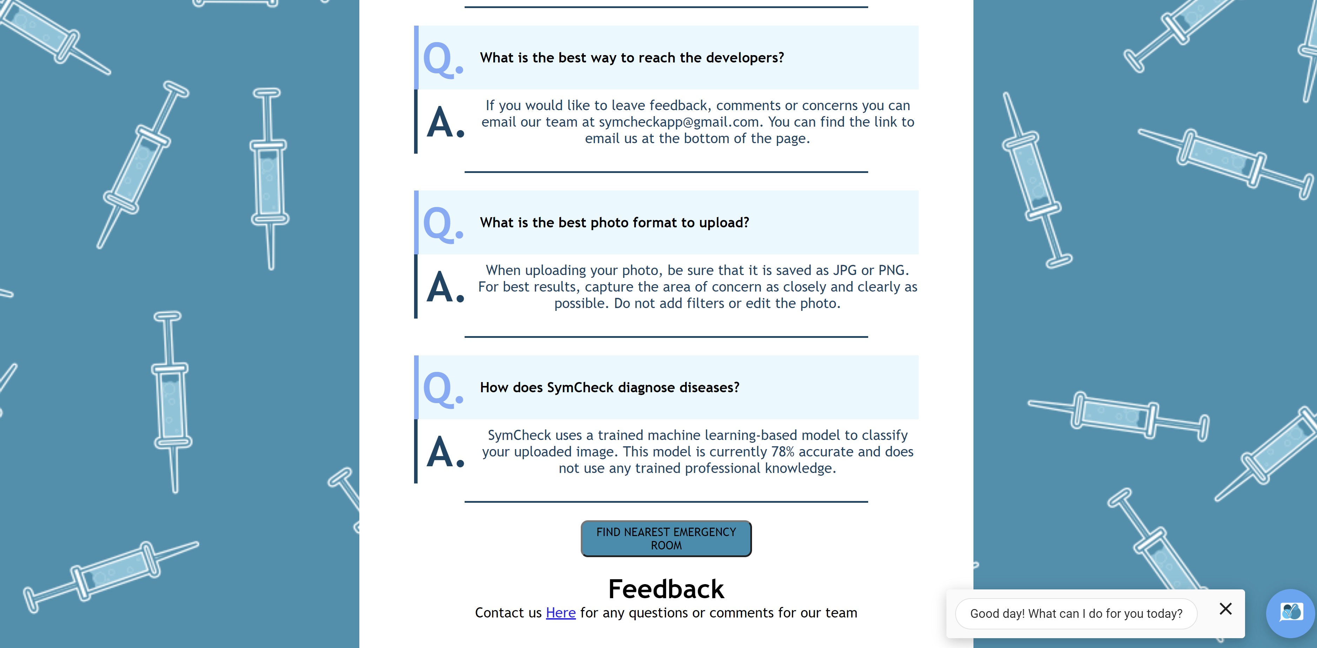
Sprint 6 Deliverable: FAQ Page
Top of Page
Bottom of Page
HiddenAgility

Slide 16
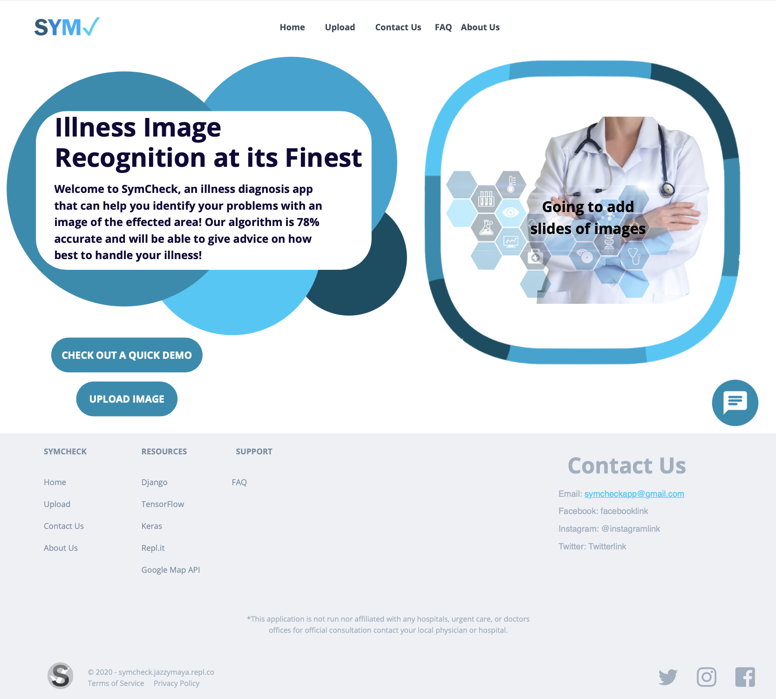
Sprint 6 Deliverable: New SymCheck Design
Homepage
HiddenAgility

Slide 17
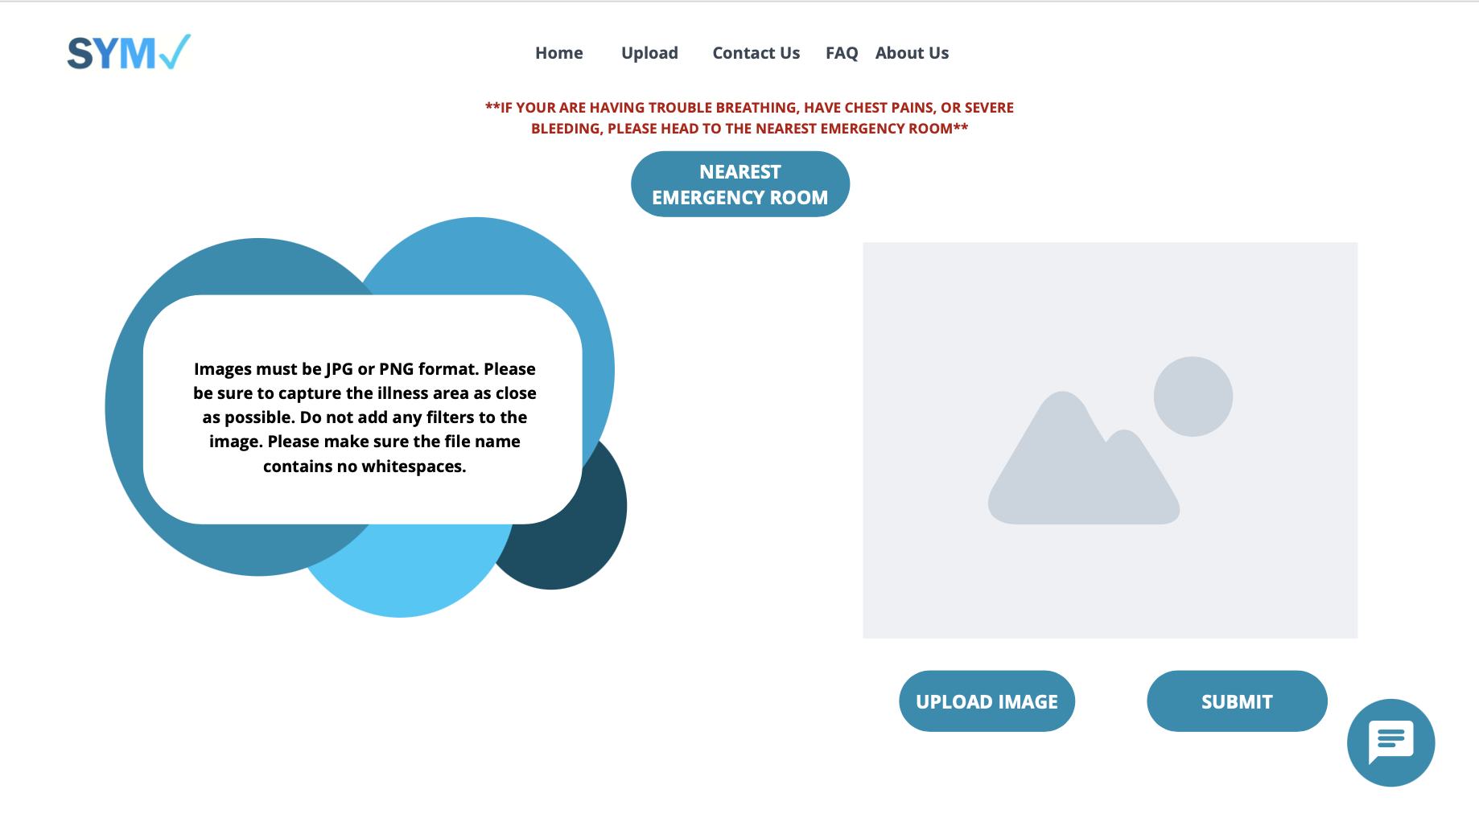
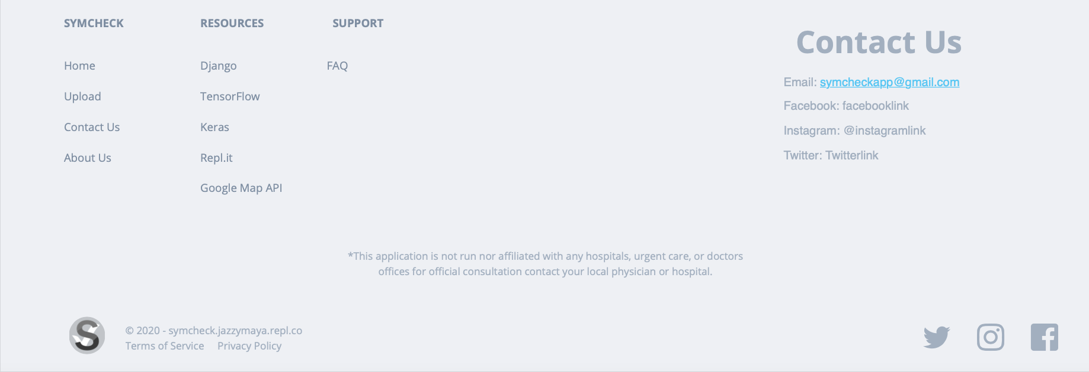
Sprint 6 Deliverable: New SymCheck Design
Upload Page
HiddenAgility

Slide 18
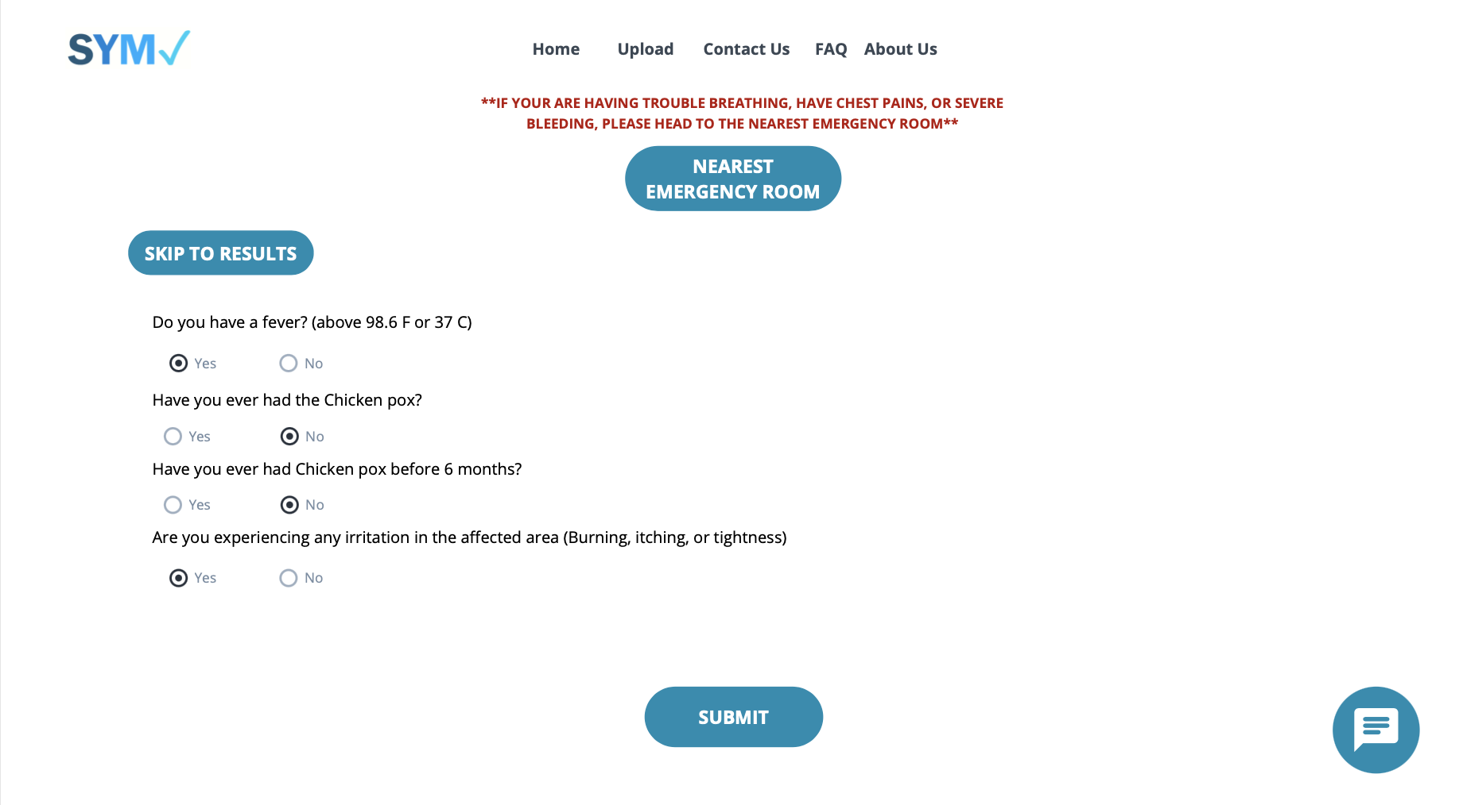
Sprint 6 Deliverable: New SymCheck Design
Advance Prediction Page
HiddenAgility

Slide 19
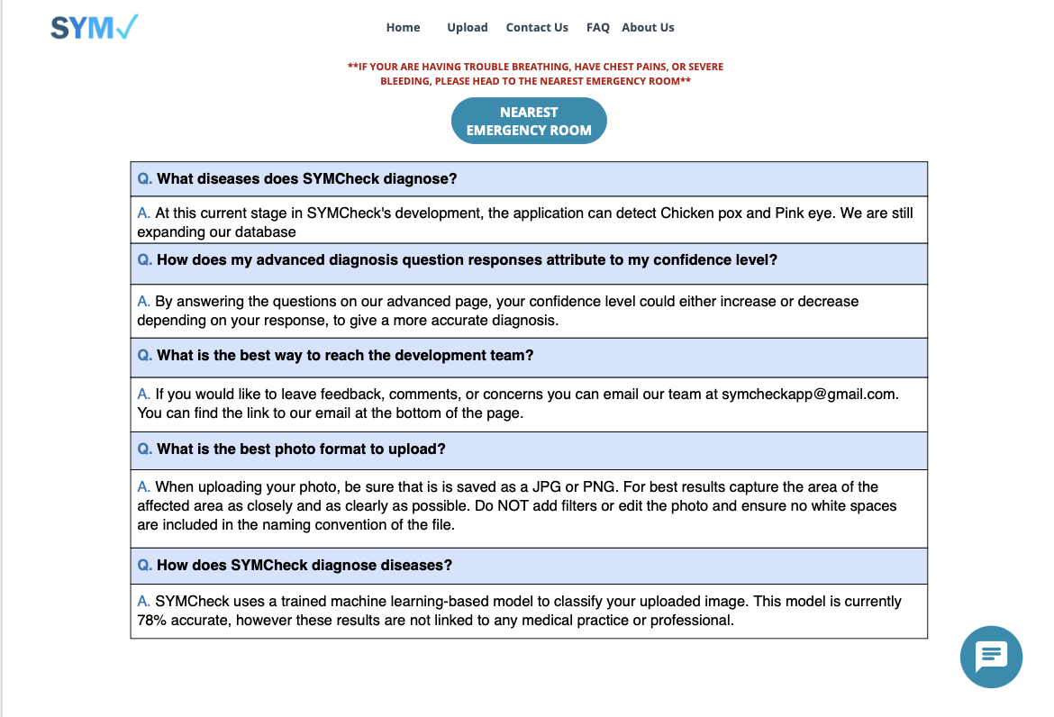
Sprint 6 Deliverable: New SymCheck Design
FAQ Page
HiddenAgility

Slide 20
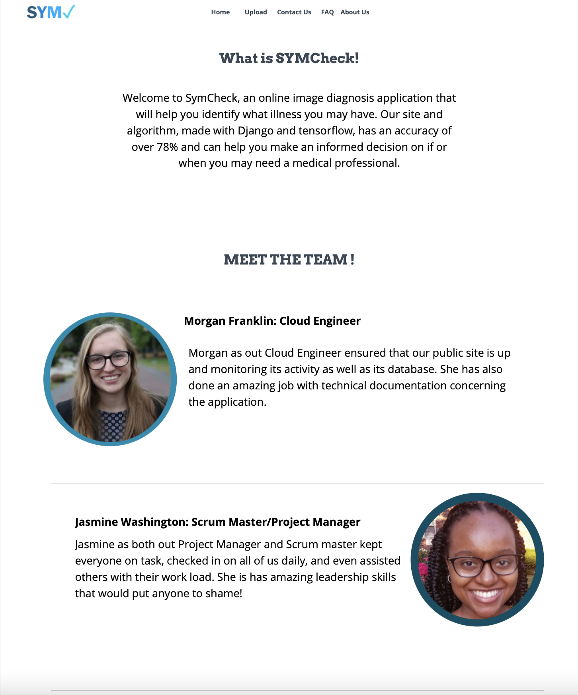
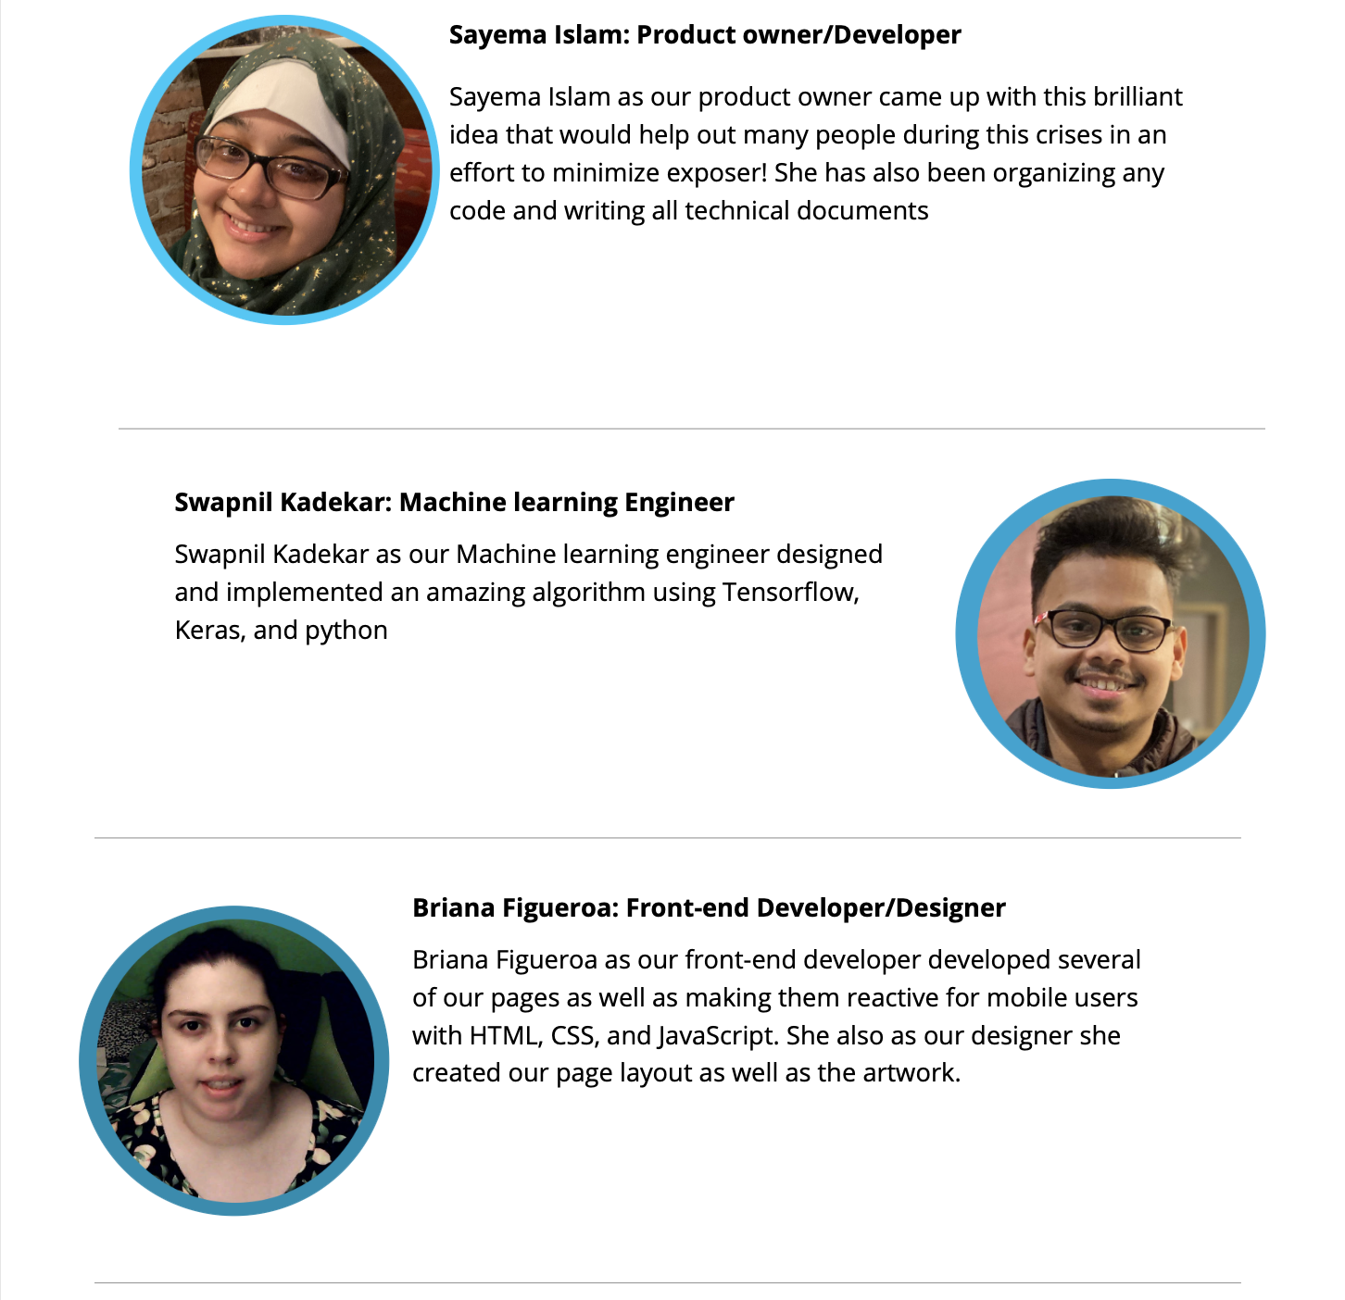
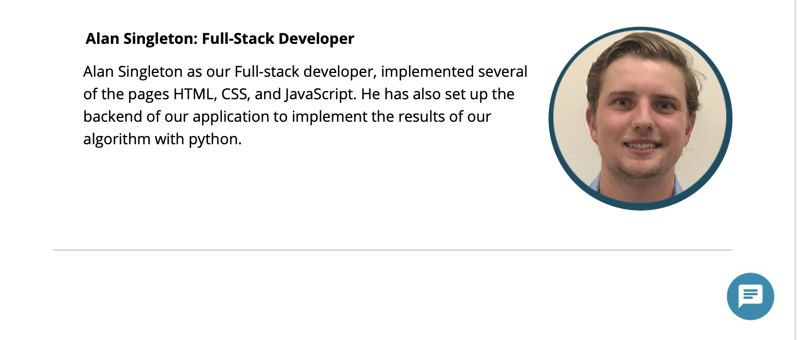
Sprint 6 Deliverable: New SymCheck Design
About Us Page
HiddenAgility

Slide 21
Acceptance Criteria and Test Case
HiddenAgility

Slide 22
Acceptance Criteria
Key | Summary | Label
HID-81 | Given that the patient is on any page, when the patient clicks the FAQ button, then the patient should access the FAQ page Given that the patient is on the FAQ page, when the patient clicks the Home button, then the patient is returned to the Homepage Given that the patient is on the FAQ page, when the patient clicks on the New Diagnosis button, then the patient is rerouted to the ImageUpload page Given that the patient is on the FAQ page, when the patient clicks the Find Nearest Emergency Room button, then the patient will see the nearest ERs and interact with the map Given that the patient is on the FAQ page, when the patient clicks the send feedback link, then the application will open the patient’s default mail app with the email section prefilled to send to symcheckapp@gmail.com | FAQ Page
HiddenAgility

Slide 23
Test Cases
Test Case For | Key | Test Cases | Test Data | Expected Results | Actual Results | Pass/Fail
FAQPage | HID-81 | Questions and Answers |  | Patient can see listed questions and respective answers | Patient sees listed questions and respective answers | P
FAQPage | HID-81 | Return to Home |  | Patient can return to the homepage | Patient is returned to the homepage | P
FAQPage | HID-81 | New Diagnosis |  | Patient can access the image upload page | Patient is rerouted to the image upload page | P
FAQPage | HID-81 | Find Nearest ER |  | Patient can access the interactive map with nearest ERs shown | Patient can use the emergency ER feature | P
FAQPage | HID-81 | Feedback | "Test" | Patient can send feedback via email to SymCheck developers | Patient can send an email to symcheckapp@gmail.com | P
HiddenAgility

Slide 24
Project Timeline
HiddenAgility

Slide 25
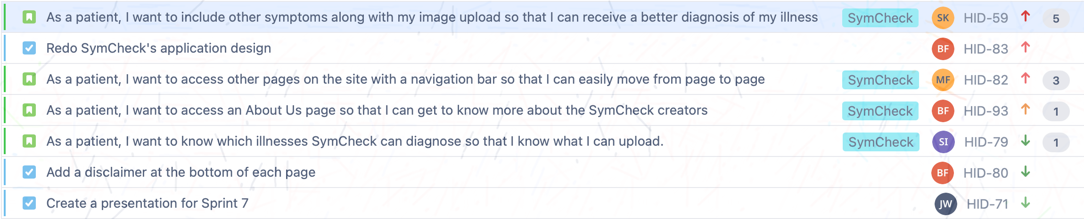
Sprint 7 (March 16 – April 5)
Metrics
4 User Stories
Sprint Goal
Completely redesign SymCheck
Highest Story
Finishing the advanced prediction page
10 Story Points Total
3 Tasks
HiddenAgility

Slide 26
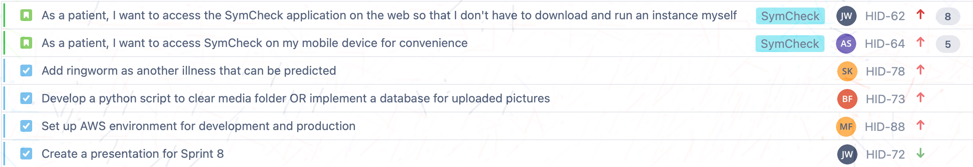
Sprint 8 (April 6 – April 27)
Metrics
2 User Stories
Sprint Goal
Highest Story
Hosting our application to the Cloud (AWS)
13 Story Points Total
4 Tasks
Host our application to the cloud and add a new illness
HiddenAgility

Slide 27
Retrospectives
HiddenAgility

Slide 28
Retrospectives
What went well
More comprehensive sprint planning to avoid scope changes
What needs improvement
Logging work done consistently
Estimating the amount of time items will be complete
Next Steps
Require members to log work done every weekday
HiddenAgility

Slide 29
Link to GitHub
Conclusion
https://github.com/jazzymaya/HiddenAgility/wiki
HiddenAgility

